Slide 1


Sponsorship Deck
2026 Summer
Your sponsorship and support is valuable contribution to promote our mission to join communities to make an impact in sports,culture and education

Slide 2
Table of Contents
Introduction to Bengals Inc 501(c)(3) ( Non-Profit Org)
Executive Committee & Non-Profit Board
Club Culture and Value
Northern California Cricket Association (est.1872)
Member Details
Sponsorship Categories & Previous Sponsors
Awards & Recognition
T&C

Slide 3
Story of Bengals_Inc
Why
Bengals Inc was established as a non-profit organization with a simple but powerful belief: sport is a universal language that builds community, character, and opportunity.
Born from the passion of cricket lovers across the Bay Area, the organization set out to create a structured, inclusive platform where people—especially local communities, young kids and teenagers—could connect, belong, and grow through sport.
In a fast-paced, digitally driven world, sports provide balance: they nurture physical health, mental resilience, discipline, teamwork, leadership, and respect. For many families, sport is also a bridge—connecting cultures, generations, and neighborhoods—while giving young people positive role models, purpose, and pathways to become future sportsmen and women.
What it Represents
At its core, Bengals Inc promotes cricket across the Bay Area as both a competitive and community sport, creating opportunities for youth and adults to play, learn, and excel.
Cricket is the foundation, but the vision goes far beyond one game. Bengals Inc aspires to evolve into a multi-sport community club—embracing running, volleyball, badminton, soccer, baseball, little league and more in the coming years.
The goal is to become a holistic sporting ecosystem that welcomes everyone: beginners and professionals, students and working adults, lifelong athletes and first-time players.
Through this, Bengals Inc aims to foster healthy lifestyles, lifelong friendships, and a strong sense of belonging rooted in shared values rather than background or geography.
How
Bengals Inc achieves this by building organized teams and leagues, partnering with schools and local districts, investing in youth development, and creating safe, well-governed pathways for participation.
The organization emphasizes volunteerism, mentorship, fair play, and community engagement—ensuring that sport is accessible, affordable, and inclusive.
Step 1 in this journey is the evolution of Bengals Cricket Club into the Golden State Cricket Club—a move driven by the desire for a larger, more inclusive brand identity that connects with the broader Bay Area community and moves away from a region-specific name.
This rebrand reflects the organization’s long-term ambition: to unite diverse communities under one banner, inspire the next generation, and use sport as a force for connection, growth, and positive social impact.

Slide 4
Bengals Inc_Org
Bengals Cricket Club is a proud part of Bengals Inc, a registered 501(c)(3) non-profit organization dedicated to fostering community connection through the love of sports. Our vibrant community includes over 160+ members from diverse ethnic and cultural backgrounds, all united by their passion for cricket.
Founded in 2018, Bengals Cricket Club has been actively competing in the Northern California Cricket Association (NCCA), representing the spirit of inclusivity and teamwork on and off the field.
In 2024, the club officially became part of Bengals Inc, the non-profit arm focused on using sports as a platform to build stronger, more connected communities. Through this initiative, we aim to provide opportunities for individuals of all ages and backgrounds to engage, compete, and grow—both as athletes and as members of our broader community.

Slide 5
Introduction to Golden State CC
Vision
Golden State Cricket Club (GSCC) was renamed (formally Bengals CC) in 2026 with the vision of inspiring next generation of cricketers in the local northern California community. The club members come from different ethnicity and age. We are constantly trying to improve as cricketers while having fun out on the ground. We currently play across all formats of cricket conducted by Northern California Cricket Association which is recognised by USA cricket and is an International Cricket Council affiliate.
Highlights
2025 Summer League champions T20
2024 Winter League Runners Up T20
League Stage 1st Place in Summer 2023 in T20 NCCA League
Quarter Finalist in Summer 2022 & 2nd Place in League stage in T20 NCCA League
Semi-Finalist in Summer 2022 in T30 NCCA League
Semi-finalist in Winter 2021 in T25 BACA League
Hosted an individual Bay Area Premier League in 2020
Member participation in USA Masters League Tournament (2022)
Past Members have participated and are currently playing for USA Minor League & Master’s League

Slide 6

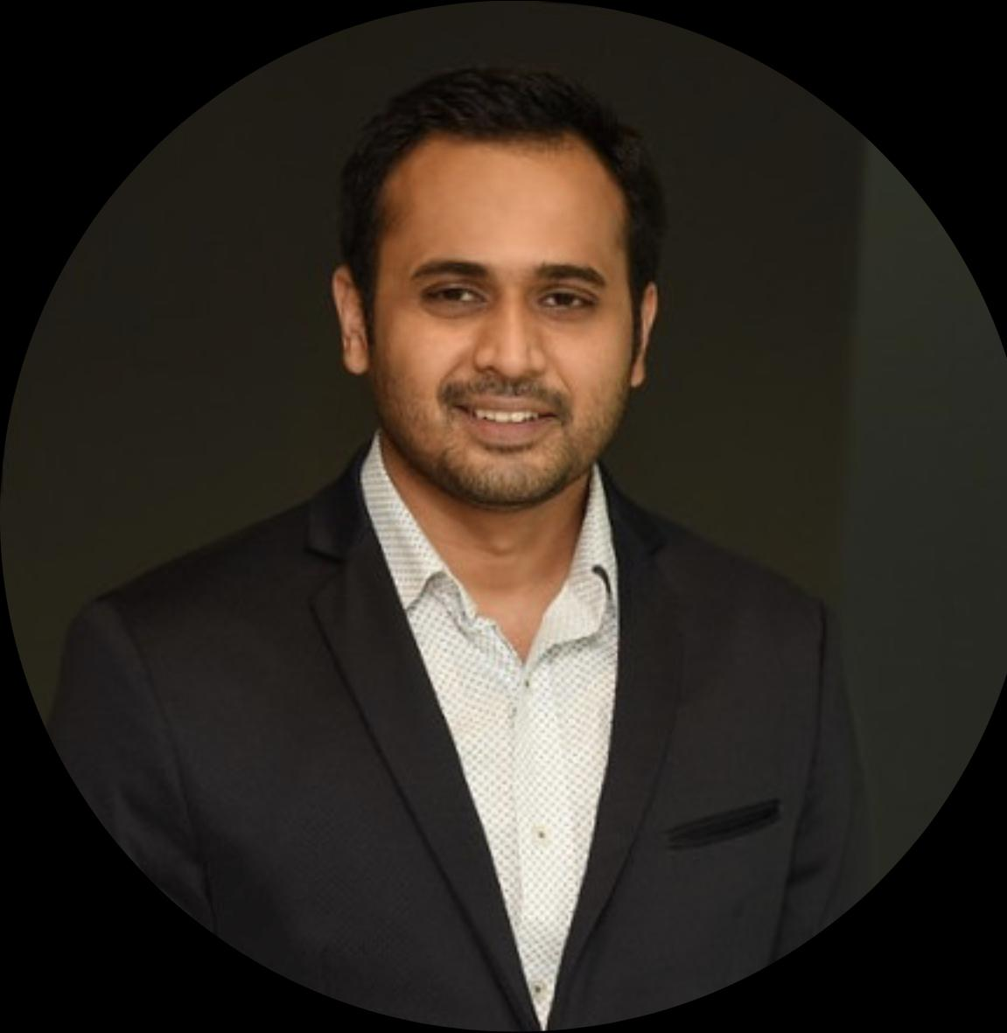



Executive Committee & Non-Profit Board
Abhimanyu Karthik
President - Golden State CC
abhimanyu.k1994@gmail.com
Sharan CK
Treasurer - Golden State CC
sharanck03@gmail.com
Dev Ravindranath
Secretary - Golden State CC
gsbengalsinc@gmail.com
Raiyan M
Non-Profit Board Member - Bengals Inc
raiyan81@gmail.com
Likith Gowda
Membership Officer - Golden State CC
likith003@gmail.com

Slide 7




Culture & Values
Meritocracy:
Accessibility:
Democracy:
Trust:
“ Value of each individual member of the club to be unbiased and based purely on merit of selection to the team ”
“ Ability to allow individuals to connect with one-another in an open transparent manner”
“ All decisions of the club are taken in a democratic manner in compliance with defined club laws ”
“ Club to act in a transparent manner with access to information open to all club members ”

Slide 8

Northern California League Details
Established in 1892, NCCA is a prestigious cricket league based out of Bay Area in Northern California
NCCA aims to promote cricket in the bay area by organizing tournaments across age groups for Youth, Men, and Women through the year. NCCA is the oldest association in the Bay Area and is recognized by USA Cricket.
2200+
Active Members
League Summary
NCCA organizes Summer league starting from April to October every year and winter league from November to March each year.
In Addition, NCCA organizes long weekend tournaments like Memorial Day Cup, July 4th Freedom Cup, Asia Cup etc.
NCCA Cricket league gets the maximum participation from teams across the Bay Area, Sacramento, and Fresno.
Games are held on weekends in grounds located in San Jose, Sunnyvale, Fremont, Milpitas, Livermore, Morgan Hill, Tracy and Davis
More than 100 teams participate in Summer + Winter leagues, with over 1100+ Players.
54+
Clubs
https://www.nccacricket.org/
140+
Teams

Slide 9
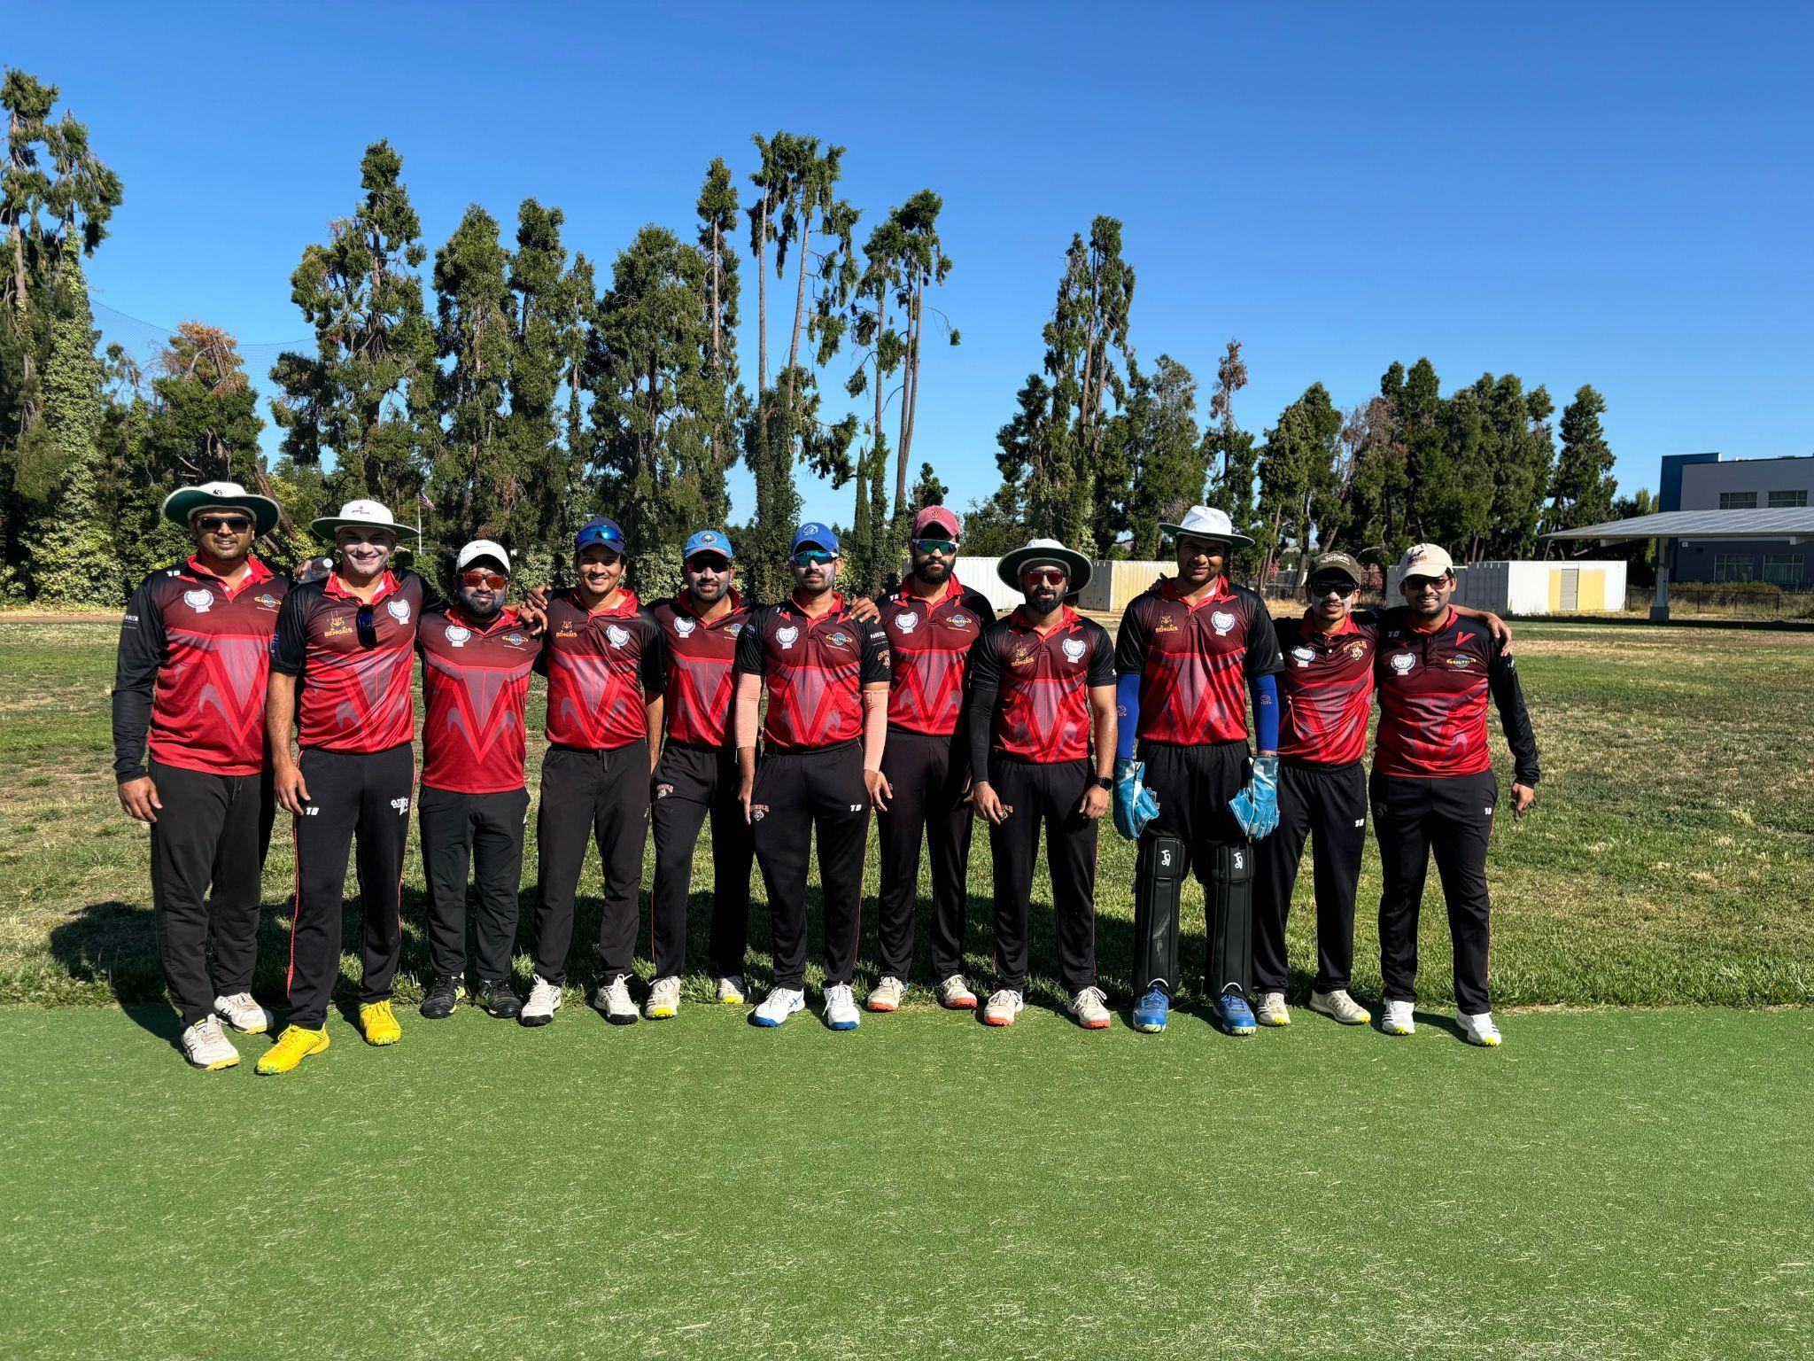
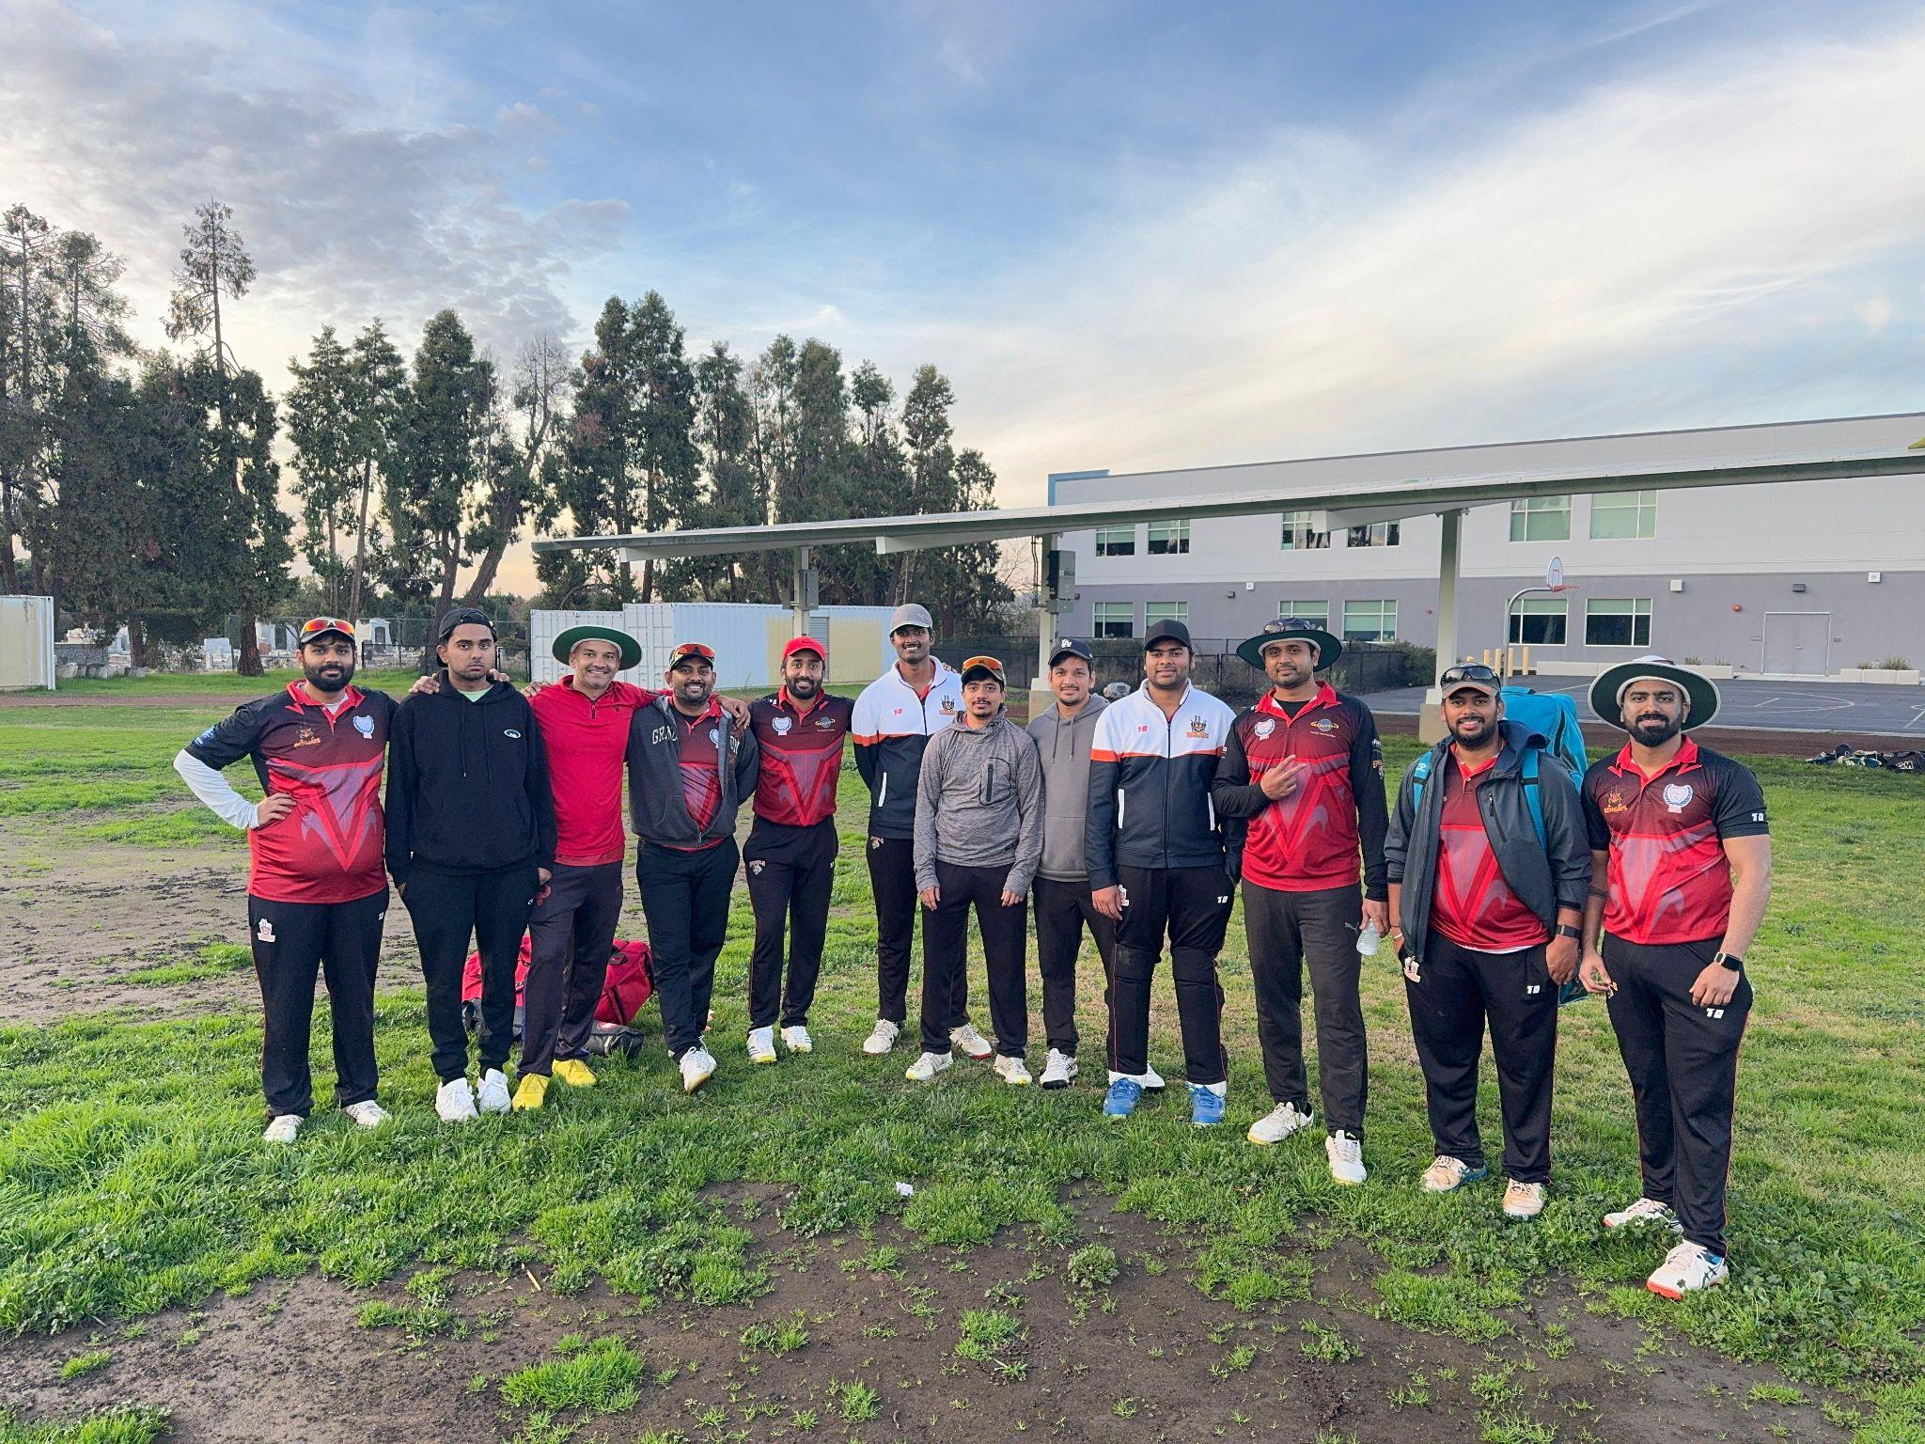
Member Details
160+
Active community Members
30+
Youth/Student
Members
8
County of Residence across Bay Area
Location of Residence | No of Members
San Jose, California | ~70
Fremont, California | ~30
San Ramon, Pleasanton, Livermore | ~20
San Francisco, Marin, Sacramento, | ~5

Slide 10
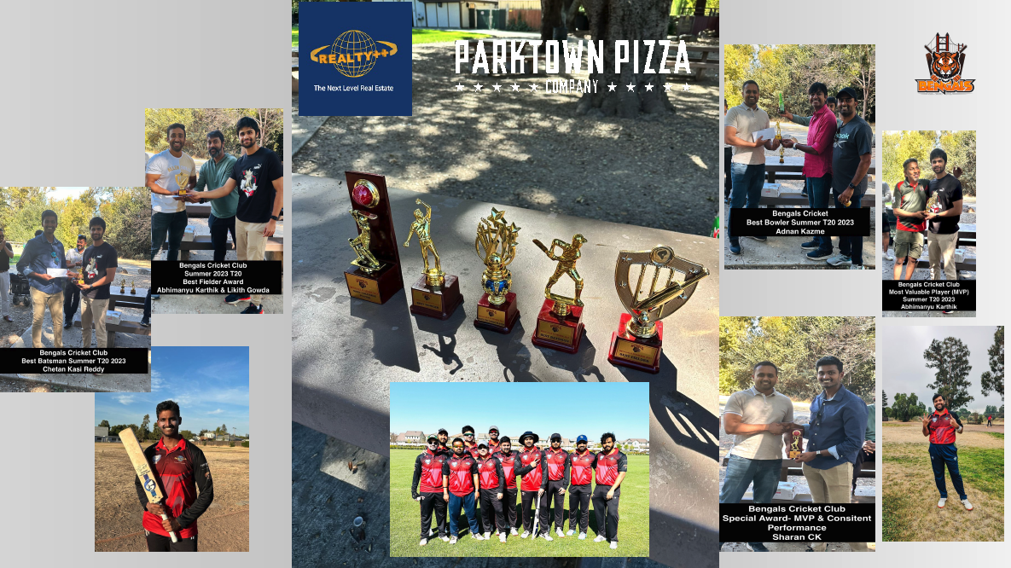
Awards & Recognitions

Slide 11
Sponsorship Request
“Why” should you sponsor ?
Sponsorship Tiers
Brand visibility and ability to support local community
Social Media presence, tagging sponsors on all communications
Platinum Sponsor (-$1500/Annual)
”Brand” logo on both front and Back of Jersey”
“Brand” Promotion on Social media channel
Target Member connections
Main Sponsor title
Invitation to Annual Member gathering
Member Activation (Min- 3 times per season)
Gold Sponsor (-$1000 (Annual)
”Brand” logo on Side sleeve of Jersey (one Sleeve)
Member Activation (1 time per season)
”Where” will my Brand be represented
Team Jerseys
Social Media Communications
You-Tube Live Stream
Invite to Club Events
Opportunity to support event hosting*
“What” is my return on sponsorship Investment
Ability to run promotional Campaigns to our exclusive club members
Target Member connections
Access to Corporate connections and student community (SJSU and Santa Clara University)
Ability to support cross-community events
*Sponsorship is for one full season and can be renewed at end of each season (Nov 2025 – March 2026)
*Sponsorship does not guarantee any direct revenue generation opportunity
*All Data shared will be with consent of members of the club. No PII data will be shared to potential sponsor
*Club will not be responsible for any financial obligations.

Slide 12







Our Previous Season Sponsors
2022
2023
2024
2025
Platinum Sponsor
Real Estate Broker & Realtor, Fremont Bay Area
India Fusion Pizza & Wings with 5 Outlets in Bay Area
India Fusion Pizza & Wings with 5 Outlets in Bay Area
Indian Pizza, Chicago based , first store in Downtown San Jose
Gold Sponsor
IT Managed Services Company, San Jose,
Bay Area
Official Jersey & Kit Partner
IT Managed Services Company, San Jose,
Bay Area
IT Managed Services Company, San Jose,
Bay Area
Official Jersey & Kit Partner
Official Jersey & Kit Partner
Practise & Ground Sponsor
Practise & Ground Sponsor
India Fusion Pizza & Wings with 5 Outlets in Bay Area

Slide 13
How we Appreciate our Sponsors
End of Season Celebrations -Summer 2025 - Click to View
Our Summer Season Sponsor Announcements 2025- Click to View
Our Summer Season Sponsor Announcements- Click to View
instagram - BengalsInc_Org

Slide 14
Notes
Sponsorship is for one full season and can be renewed at end of each season
• Jersey will have sponsor logo and will be in-compliance with league rules.
• Bengals CC is in the process of considering filling for Non-profit organization and currently cannot provide any
tax rebate documents
• Sponsorship does not guarantee any direct revenue generation opportunity
• All Data shared will be with consent of members of the club. No PII data will be shared to potential sponsor
• Club or Executives representing club will not be responsible for any financial obligations

